Slide 1
Software requirement specification
For blood donation website

Slide 2
TOPICS UNDER SRS
PURPOSE
SCOPE
FUNCTIONAL REQUIREMENTS
NON FUNCTIONAL REQUIREMENTS
SYSTEM FEATURES
BLOCK DIAGRAM
CASE DIAGRAM

Slide 3
1. Purpose
THE PURPOSE OF THIS SRS IS TO DEFINE THE REQUIREMENT FOR THE BLOOD DONATION MANAGEMENT SYSTEM
MANAGEMENT SYSTEM THAT CONNECT DONORS, RECIPENTS,AND HOSPITALS/BLOOD BANKS FOR ESSENTIAL BLOOD DONATION AND AVAILABILITY
TO ENSURE TIMELY AVAILABILITY FOR PATIENTS NEED

Slide 4
2.SCOPE
Provide donor registration and eligibility verification
Maintain donor health and donation and history
Manage hospital and blood bank stock records
Handle blood requests and automatically match them with available donors or stock
Send notifications(via email/SMS)for donation drives
Urgent requests, donor reminder
Generate reports

Slide 5
benefits
Blood donation management
Blood procurement
Blood safety
Blood and blood component production
Blood and blood component storage and distribution
Blood transfusion management
Routine blood transfusion
Emergency issue of blood

Slide 6
3.Functional requirement donor module
Register with personal and health details
Update health information
Eligibility check (system prevents donation if not eligible)
View past donations and next eligible
Receive notification for donation request

Slide 7
RECIPIENT MODULE
Register and request blood
Search for available blood groups
contact nearest blood blank
View request status

Slide 8
Blood bank/hospital module
Update available blood stock by type and quality
Approve or decline blood request
Generate reports on stock, donor contributions, and request
Update available blood stock

Slide 9
Admin module
Manage donors, recipients, and hospitals
Ensure compliance with donation regulations
View and export system reports
Monitor fraudulent or duplicate accounts

Slide 10
Performance requirement
Handle at least 1000 concurrent users
Response time<3 seconds for critical operations
Date encryption (SSL/TLS)
Role-based access control (donor/recipient/admin)
Secure authentication (OTP/email verification)

Slide 11
Usability requirements
User-friendly interface with simple navigation.
Multilingual support
Mobile friendly design
System available 24/7 with backup servers
Automatic recovery in case of crash or downtime

Slide 12
Maintainability and scalability
Modular design for future upgrades
Scalable database to support large donor/recipient base

Slide 13
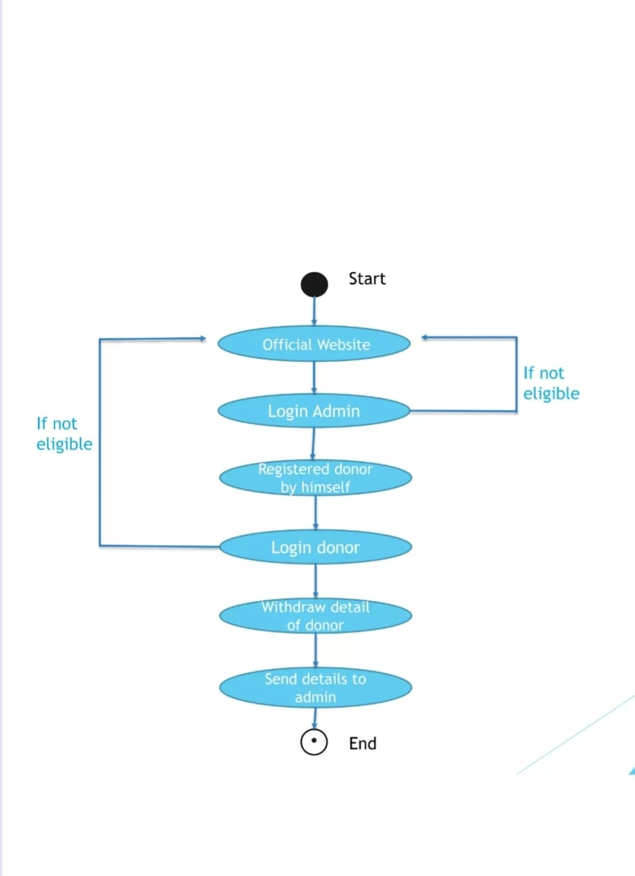
Block diagram

Slide 14
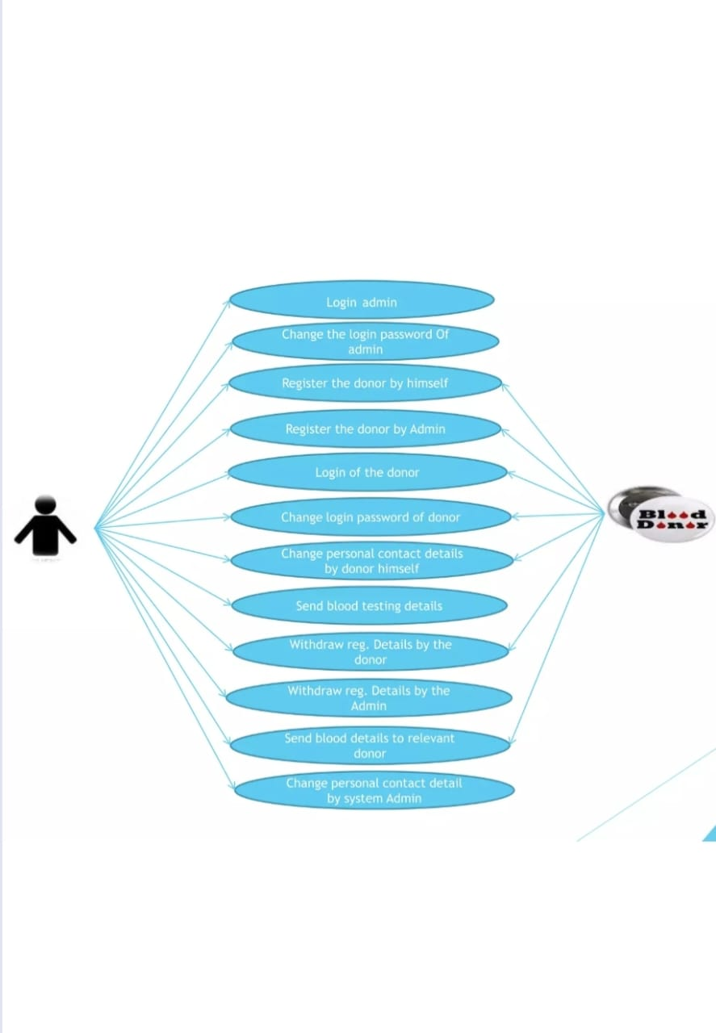
Case diagram

Slide 15
THANK YOU BY:EEV(VLSI) AMARESH.C

